Slide 1

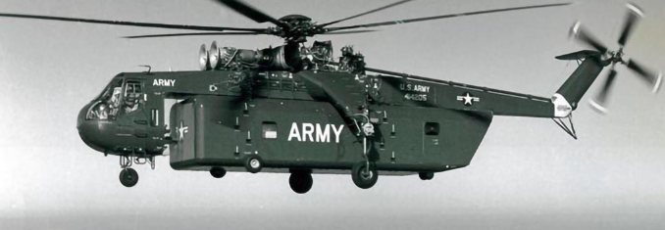

Sikorsky S-64 Skycrane – Lifting the Impossible
Justin Millsap
ARO – 3011 – 02
October 12th, 2023

Slide 2

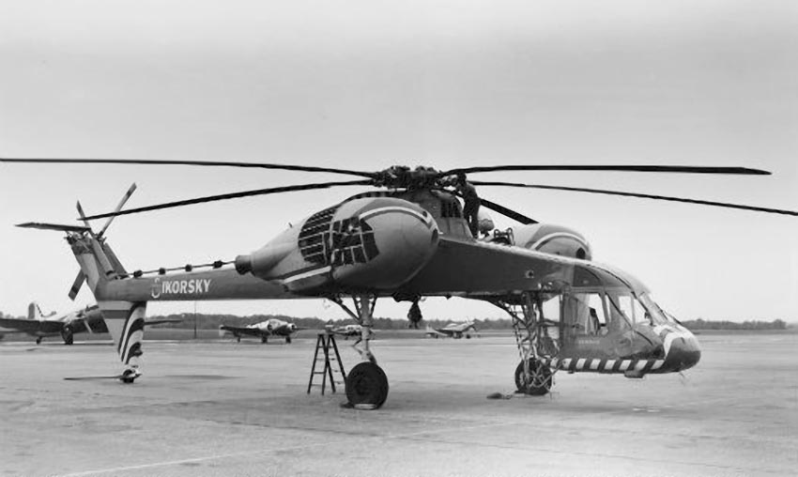
Need for the Sikorsky S-64 Skycrane
What did the S-64 need to satisfy?
Heavy cargo transport
Quick-safe-efficient turn-around time
Lifting capabilities in rigid spaces
Previous Model : Sikorsky S-60 (Fig 2.1)
Comparison between S-64 vs. S-60
Maximum Take off Weight
S-64: 38,000 pounds
S-60: 31,200 Pounds
Empty Weight
S-64: 17,240 pounds
S-60: 19,613 Pounds
Number of Blades
S-64: 6 Blades
S-60: 5 Blades
Fig 2.1 - Sikorsky S-60

Slide 3
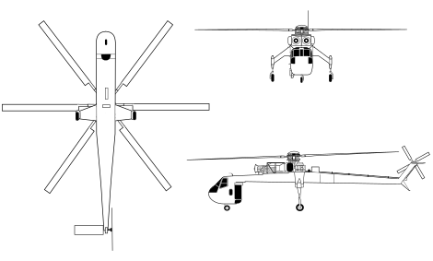
Sikorsky S-64 Skycrane Configuration
No Cabin - "Stick Fuselage"
2 Pratt & Whitney JFTD – 12 Turbine engines
72 – ft Diameter Rotor (6 blades)
Tail skid
Tricycle landing gear
Fly-by-wire controls
Rear Facing Cockpit

Slide 4
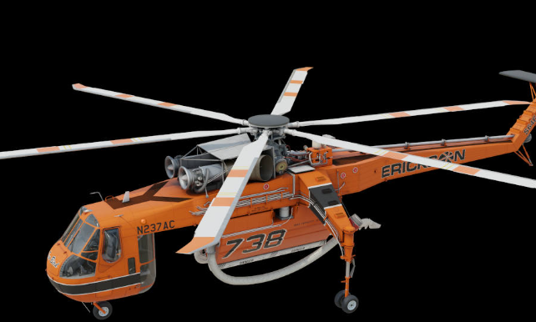
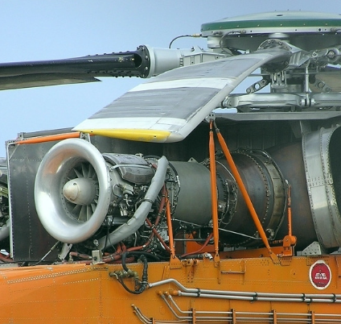
"Low-speed" Aerodynamics/propulsion design attributes
Aerodynamic attributes
Large rotor blades – Produces more lift + allows heavier payloads.
Tail Rotor – Counteracts the torque produces by main rotor blades for stability.
Transmission tiled 3 degrees
Propulsion attributes
Two Pratt and Whitney engines to produce necessary lift
Variable Pitch rotors to control stability during different level loads

Slide 5

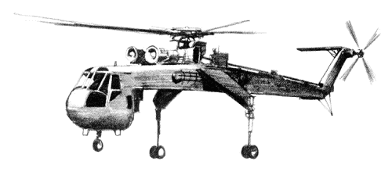
Design and Manufacturing
Company: Sikorsky Aircraft Corporation
Initial Development to first prototype flight: April 1961 (Program "Go-Ahead") -> May 1962 (First flight)
Number Produced: 99
Unit Cost: ~ $30 million
Operational life cycle: 1962 - Present

Slide 6

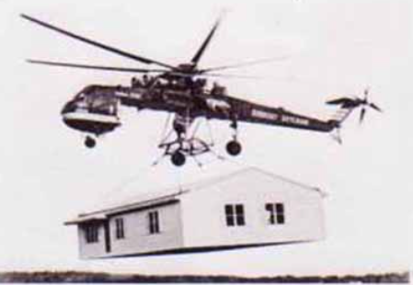
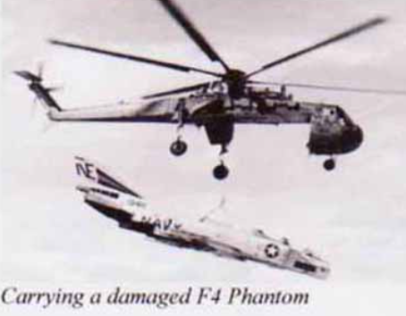
Impact of the S-64 Skycrane
Military Application:
During the 1950's & 1960's the S-64 was used to frequently transport troops, fuel, ammunition, & equipment to bases
Alpine National Park Fire ( Jan 5th – 14th 1998):
94 loads ~ 810,000 Liters used for fire suppression
Impact on Future Designs
Successful external load operations influenced future use of S-64
Knowledge gained from S-64 helped the development of the Sikorsky S-92 & CH-53K
References:
https://sikorskyarchives.com/home/sikorsky-product-history/helicopter-innovation-era/sikorsky-s-64/

